Slide 1
Banksy NFT Concept Development
Blockchain Crowdsale
[via Solidity/Streamlit]
Authors: Anthony Franco, Jason Souffront and Nick Mescain

Slide 2
Backstory
Growing up in the dire and hard streets of Malibu, FL it was almost impossible not to notice the vapidly growing movements tied to common street art
Many partook in this movement with great merit but few have had as profound and lasting an impact as the unkown mastermind AKA “Banksy”
To reflect on the appreciation and gratitude we have for this unkown artists’ work – we’ve decided to collaborate on a developmental initiative to bring his/her art to the front of the disruptive online-tech stage of the Blockchain Trading Metaverse

Slide 3
But we need your help!

Slide 4
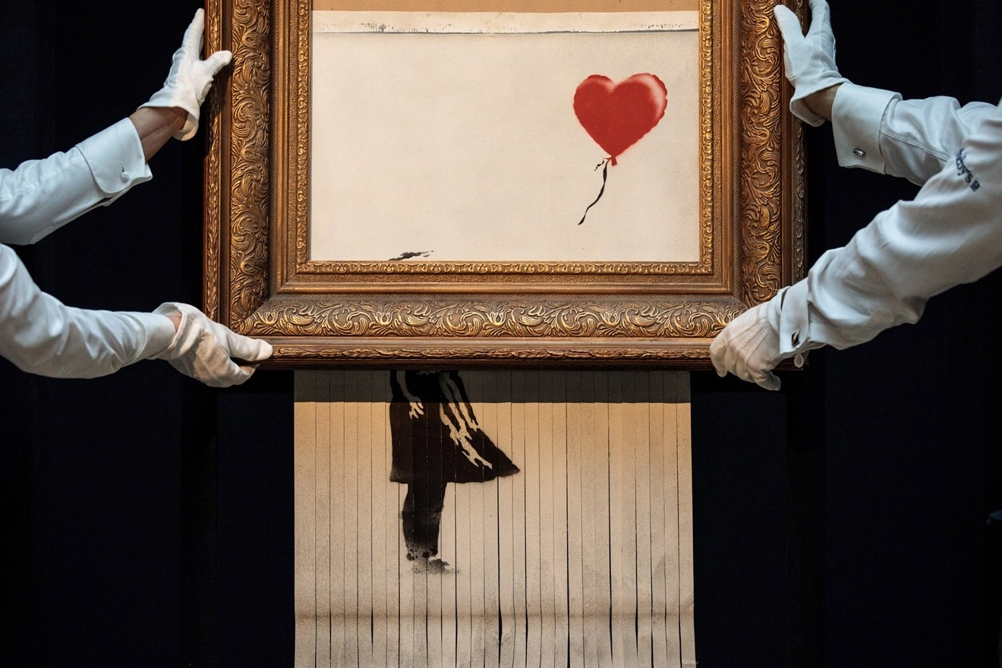
[Concept Artwork]
[Selling pts] – History, Culture, Emotion Evoking
(ex: “spans 30+ years of open source Street Art”)
The rich and the dastardly
Standard Rate: 10,000 Wei/Token
(ex: “Donate to this initiative today and receive your first NFT on go-live for 50% off standard rate”)
Letting go

Slide 5
What your donation will do for you
Bring you to the front of an inevitably growing market
Increase confidence in your decision making for the amount of monetary impact you will soon have on the ever evolving digital art world

Slide 6
What your donation will do for your community

Slide 7
We appreciate your time and consideration
Now let’s make this a reality!

